Slide 1
Physics Jeopardy!

Slide 2
Choose Category & Amount
Nobel Prizes | Affairs of the Heart | The Dark Side | Intro Physics | Name that Formula | Name that Physicist
200 | 200 | 200 | 200 | 200 | 200
400 | 400 | 400 | 400 | 400 | 400
600 | 600 | 600 | 600 | 600 | 600
800 | 800 | 800 | 800 | 800 | 800
1000 | 1000 | 1000 | 1000 | 1000 | 1000

Slide 3
Final Jeopardy Category:
Pop culture

Slide 4
Final Jeopardy
The international space station, a fired bullet, and Tom Petty, are all in this.
Back
Question

Slide 5
Questions
Nobel Prizes | Affairs of the Heart | The Dark Side | Intro Physics | Name that Formula | Name that Physicist
5.10 m/s | It will triple | Newton’s 2nd Law | Force applied over a distance | 3150 Joules | 13,600 Hz
1.6 m/s² | 150 Newtons | Newton’s 1st Law | The rate of doing work | 357 Joules | 9.78 meters
Slowing down | Acceleration | Inertia | 70 Joules | Elastic Potential Energy | 5.0 meters
3.67 hr or (3 hr 40 min) | 0.25 kg | Newton’s 3rd Law | Zero – no distance moved | It increases | 354 Hz
Acceleration | 33.3 N | Newton’s 3rd Law | 5 Watts (or J/s) | Gravitational Potential Energy | 4.0 meters

Slide 6
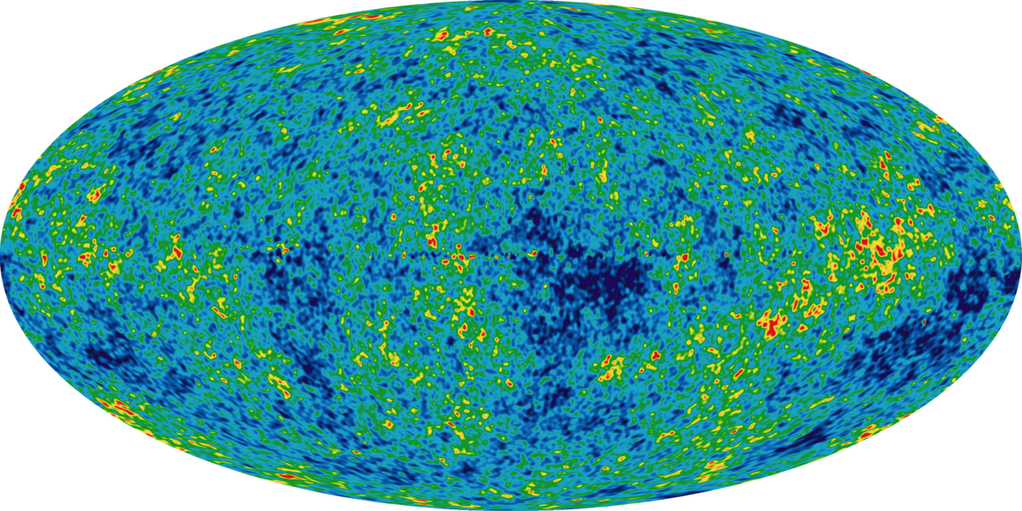
Nobel Prizes 200
Visualized here, Penzias and Wilson received the Nobel prize in 1978 for their discovery of this.
Back
Question

Slide 7
Nobel Prizes 400
Often known as the father of atomic physics, Ernest Rutherford claimed he was a bit “startled” at receiving the 1908 Nobel Prize not for physics, but for this discipline.
Back
Question

Slide 8
Nobel Prizes 600
This Nobel Laureate received the award for work on quantum electrodynamics in 1965, but is also known for playing the bongos.
Back
Question

Slide 9
Nobel Prizes 800
In 1944, Otto Hahn alone received the Nobel Prize for this discovery, while co-discoverers Lise Meitner and Fritz Strassmann were snubbed.
Back
Question

Slide 10
Nobel Prizes 1000
In 1921, Einstein received the Nobel prize, not for the theory of relativity, but “for his services to theoretical physics, and especially his discovery of”… this.
Back
Question

Slide 11
Affairs of the Heart 200
He left his first wife, a fellow physicist, for his first cousin, Elsa.
Back
Question

Slide 12
Affairs of the Heart 400
Although tall, handsome, and impeccably dressed, this prolific physicist and inventor was not known to have any romantic relationships in life. He did, however die with an unusual devotion to… pigeons.
Back
Question

Slide 13
Affairs of the Heart 600
Some say that Jean Tatlock’s suicide was related to her estrangement from this former lover and head of the Manhattan Project.
Back
Question

Slide 14
Affairs of the Heart 800
Her affair with Parisian Mathematician Paul Langevin was rebuked by the Nobel Prize Committee in 1911.
Back
Question

Slide 15
Affairs of the Heart 1000
While he was helping to build a bomb in Los Alamos, New Mexico, this charismatic physicist’s wife Arline was living in a Sanatorium in Albuquerque. In a love letter written to her two years after her death, he wrote the following post-script: “Please excuse my not mailing this- but I don’t know your new address.”
Back
Question

Slide 16
The Dark Side 200
Three years after he shared the Nobel prize in Physics with his wife for the study of radiation, Pierre Curie met his unfortunate death in the streets of Paris when his skull was crushed by this.
Back
Question

Slide 17
The Dark Side 400
This English Physicist once stuck a blunt sewing needle deep into his eye to investigate the science of sight.
Back
Question

Slide 18
The Dark Side 600
Although more well known to introductory physics students for a law describing forces on springs, this physicist once got inside a person-sized vacuum chamber as a demonstration for the Royal Society of London.
Back
Question

Slide 19
The Dark Side 800
In a campaign against George Westinghouse and alternating current technology, this “Wizard of Menlo Park” electrocuted an elephant.
Back
Question

Slide 20
The Dark Side 1000
This body part of Galileo Galilei is allegedly on display in the History of Science Museum in Florence, Italy.
Back
Question

Slide 21
Intro Physics 200
The acceleration of a rock thrown straight upward, at the top of it’s trajectory.
Back
Question

Slide 22
Daily
Double
Answer

Slide 23
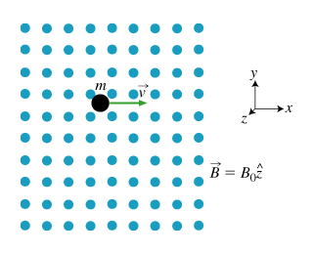
Intro Physics 400
Back
Question
The direction that this negatively charged particle feels at the instant shown.

Slide 24
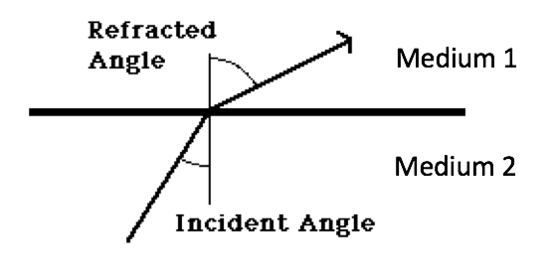
Intro Physics 600
Back
Question
The medium with the larger index of refraction.

Slide 25
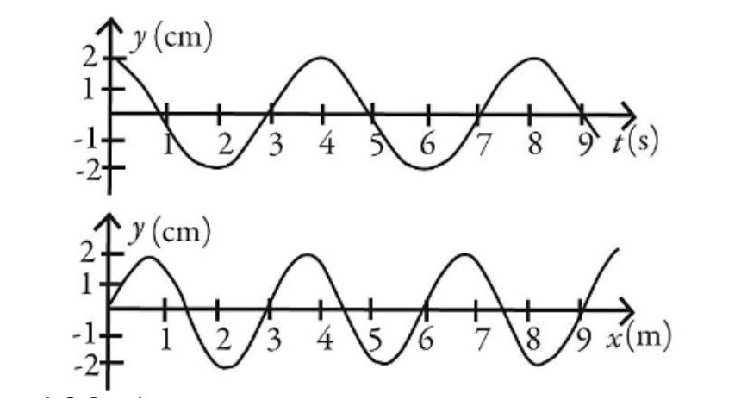
Intro Physics 800
Back
Question
The speed of a traveling wave represented by the two graphs shown.

Slide 26
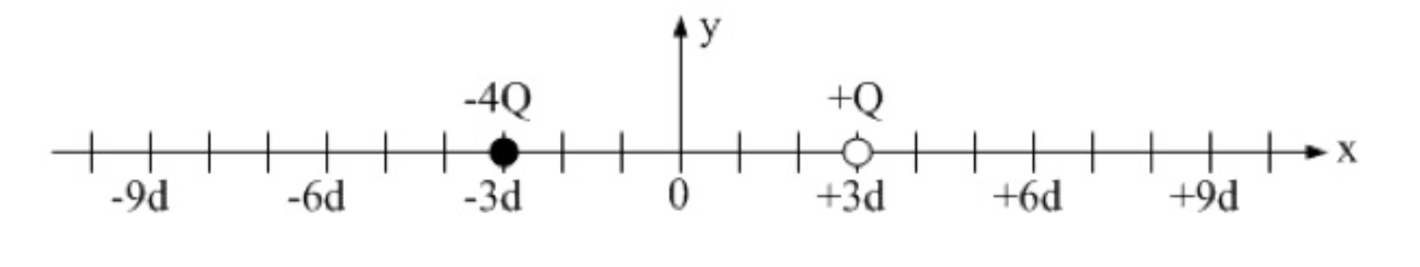
Intro Physics 1000
Back
Question
A location on the line where the electric field is zero.

Slide 27
Name that Formula 200
Back
Question

Slide 28
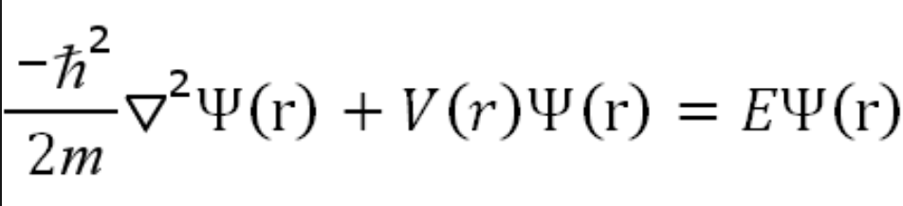
Name that Formula 400
Back
Question

Slide 29
Name that Formula 600
Back
Question

Slide 30
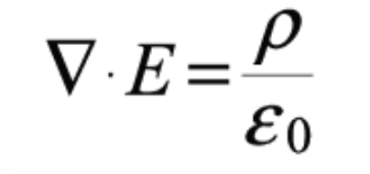
Name that Formula 800
Back
Question

Slide 31
Name that Formula 1000
Back
Question

Slide 32
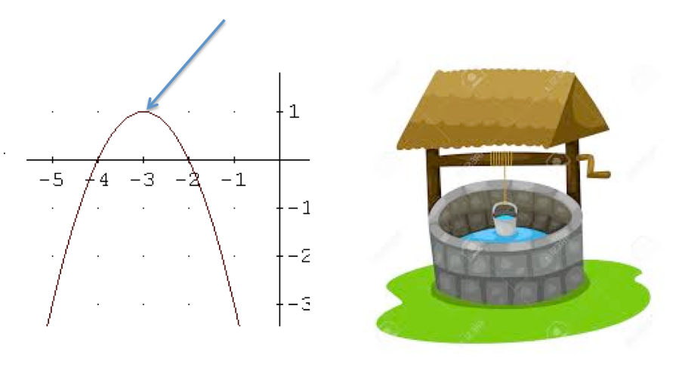
Name that Physicist 200
Back
Question

Slide 33
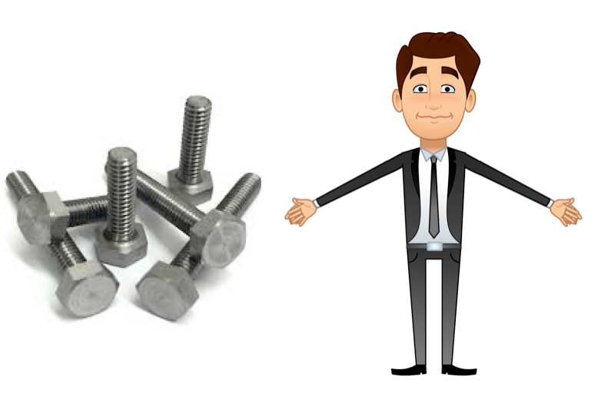
Name that Physicist 400
Back
Question

Slide 34
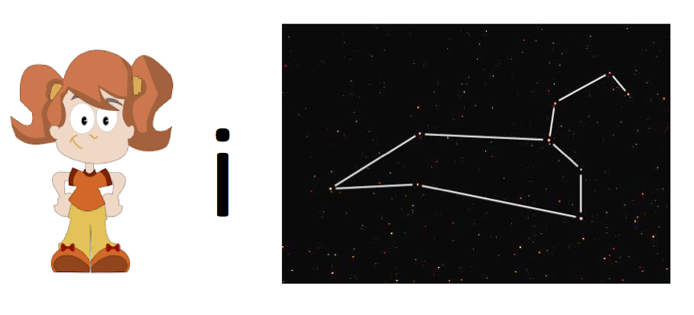
Name that Physicist 600
Back
Question

Slide 35

Name that Physicist 800
Back
Question

Slide 36

Name that Physicist 1000
Back
Question

Slide 37
Nobel Prizes 200 Question
What is the Cosmic Microwave Background Radiation?
Back to Board

Slide 38
Nobel Prizes 400 Question
What is chemistry?
Back to Board

Slide 39
Nobel Prizes 600 Question
Who is Richard Feynman?
Back to Board

Slide 40
Nobel Prizes 800 Question
What is fission?
Back to Board

Slide 41
Nobel Prizes 1000 Question
What is the law of the photoelectric effect?
Back to Board

Slide 42
Affairs of the Heart 200 Question
Who is Albert Einstein?
Back to Board

Slide 43
Affairs of the Heart 400 Question
Who is Nikola Tesla?
Back to Board

Slide 44
Affairs of the Heart 600 Question
Who is J. Robert Oppenheimer? Back to Board

Slide 45
Affairs of the Heart 800 Question
Who is Marie Curie?
Back to Board

Slide 46
Affairs of the Heart 1000 Question
Who is Richard Feynman?
Back to Board

Slide 47
The Dark Side 200 Question
What is a carriage?
Back to Board

Slide 48
The Dark Side 400 Question
Who is Isaac Newton?
Back to Board

Slide 49
The Dark Side 600 Question
Who is Robert Hooke?
Back to Board

Slide 50
The Dark Side 800 Question
Who is Thomas Eddison?
Back to Board

Slide 51
The Dark Side 1000 Question
What is his finger?
Back to Board

Slide 52
Intro Physics 200 Question
What is g=9.81 m/s²?
Back to Board

Slide 53
Intro Physics 400 Question
What is up?
Back to Board

Slide 54
Intro Physics 600 Question
What is medium 2?
Back to Board

Slide 55
Intro Physics 800 Question
What is ¾ m/s?
Back to Board

Slide 56
Intro Physics 1000 Question
What is +9d?
Back to Board

Slide 57
Name that Formula 200 Question
What is Ohm’s Law?
Back to Board

Slide 58
Name that Formula 400 Question
What is Schrodinger’s Equation?
Back to Board

Slide 59
Name that Formula 600 Question
What is Newton’s 2nd Law?
Back to Board

Slide 60
Name that Formula 800 Question
What is Gauss’s Law?
Back to Board

Slide 61
Name that Formula 1000 Question
What is the Stefan-Boltzmann Law?
Back to Board

Slide 62
Name that Physicist 200 Question
Who is Maxwell?
Back to Board

Slide 63
Name that Physicist 400 Question
Who is Boltzmann?
Back to Board

Slide 64
Name that Physicist 600 Question
Who is Galileo?
Back to Board

Slide 65
Name that Physicist 800 Question
Who is Einstein?
Back to Board

Slide 66
Name that Physicist 1000 Question
Who is Faraday?
Back to Board

Slide 67
Final Jeopardy Question
What is free fall?
Back to Board

